Slide 1
Δίκτυα Υπολογιστών Ι

Slide 2
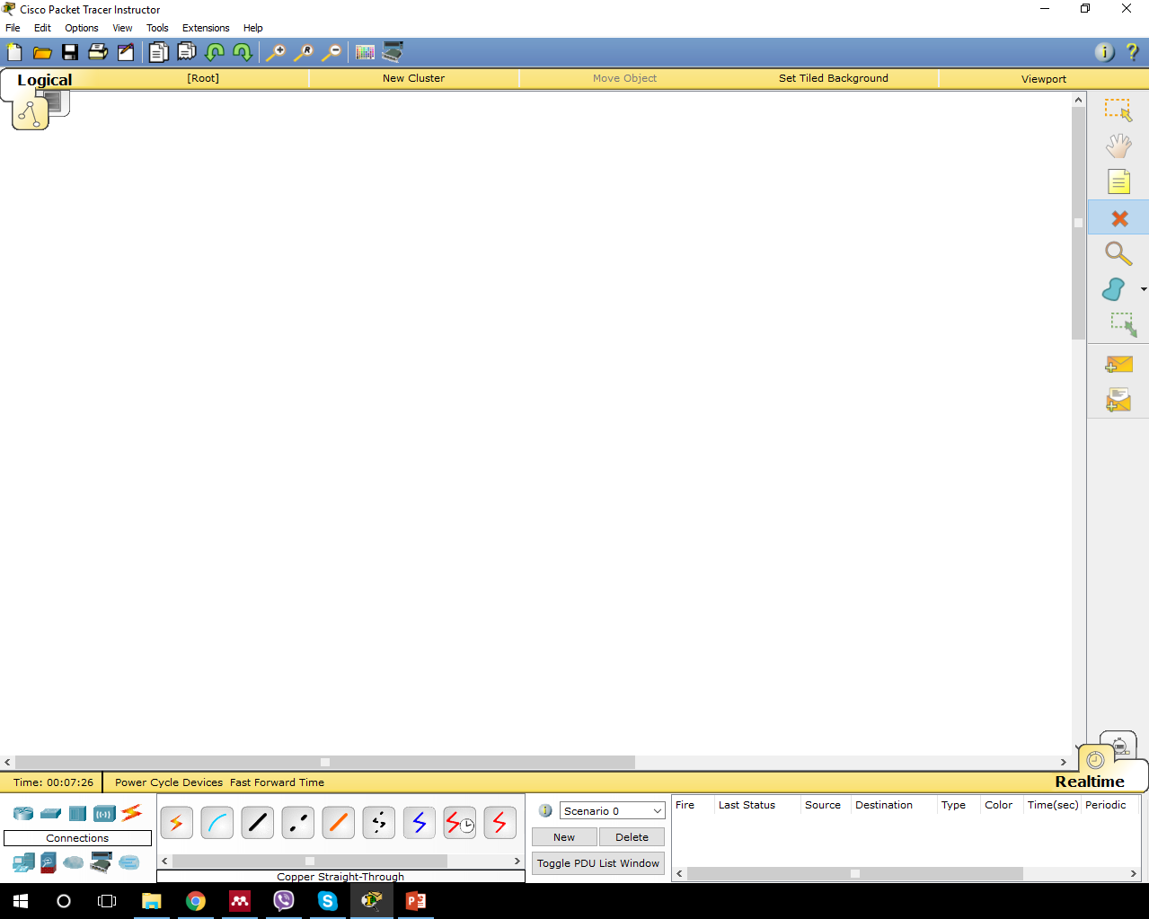
Cisco Packet Tracer

Slide 3
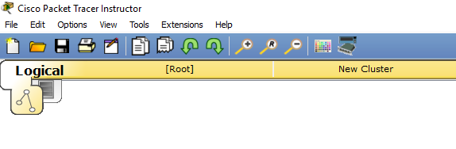
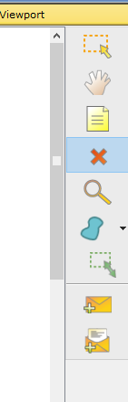
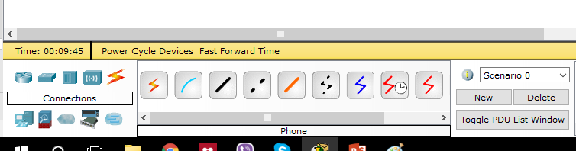
Cisco Packet Tracer

Slide 4
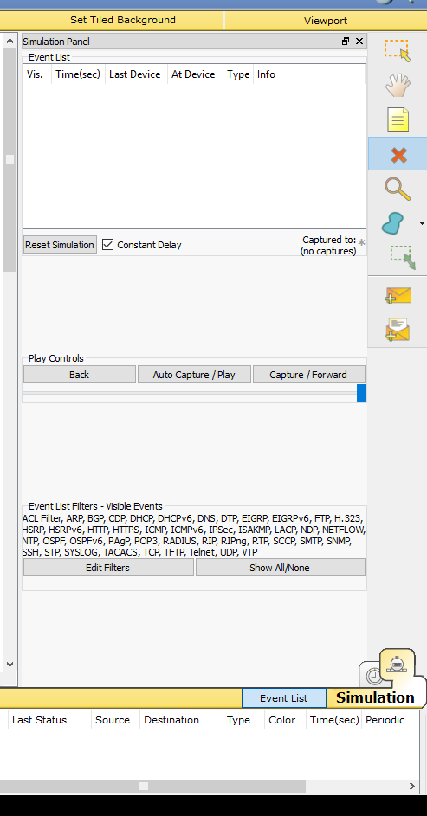
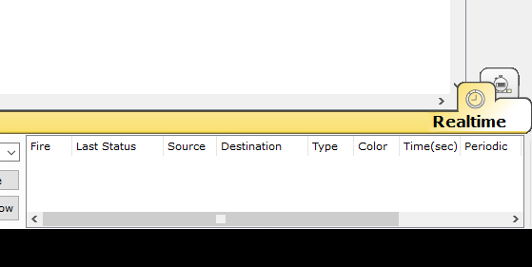
Cisco Packet Tracer

Slide 5
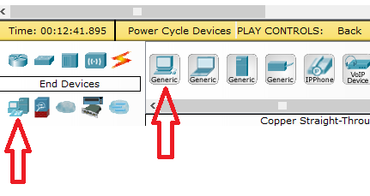
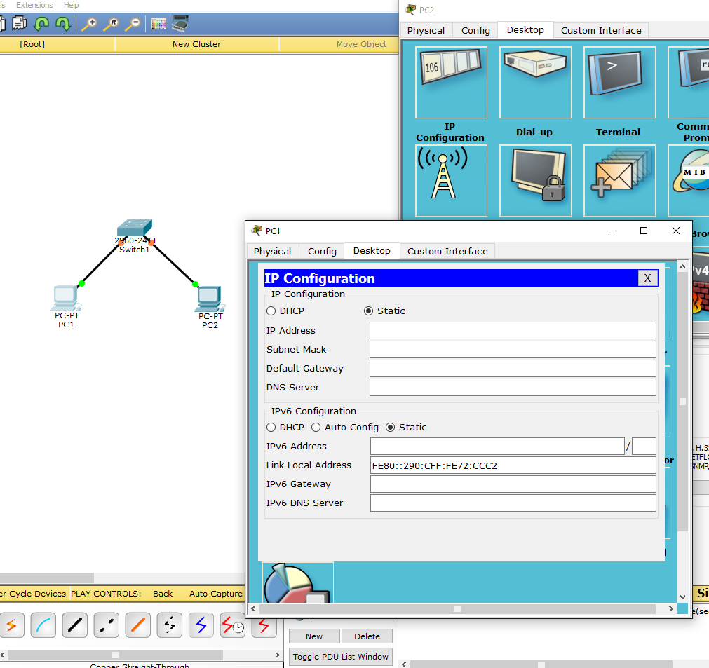
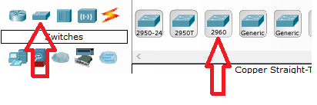
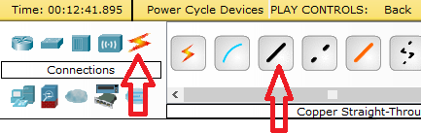
Cisco Packet Tracer

Slide 6
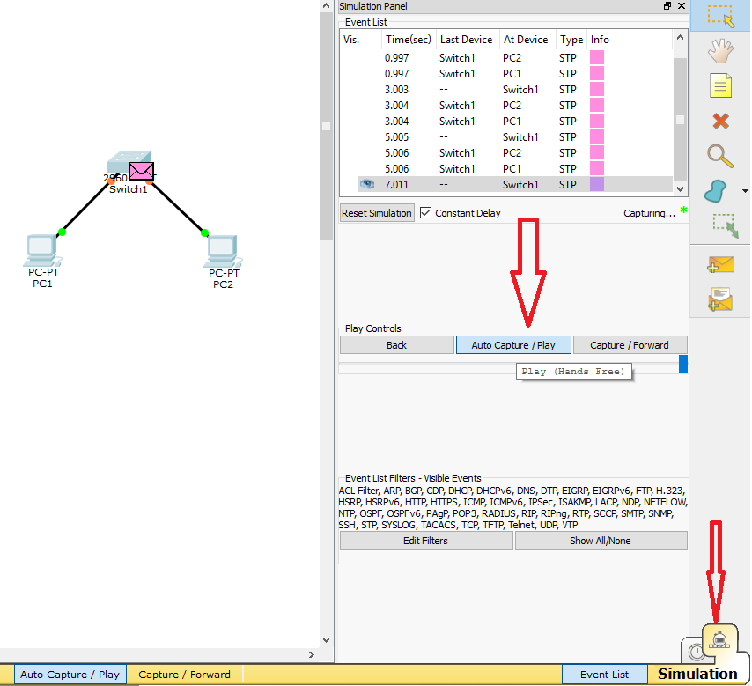
Cisco Packet Tracer

Slide 7
Variable Length Subnet Mask (VLSM)
Έχω ένα δίκτυο 172.16.0.0/16
Θέλουμε ένα δίκτυο 4000 host
Ένα δίκτυο 1000 host
Ένα δίκτυο 100 host
Και τρία δίκτυα 2 host

Slide 8
VLSM
4000 hosts → 4096 addresses
172.16. _ _ _ _|_ _ _ _ . _ _ _ _ _ _ _ _
ID | RANGE | BROADCAST | CIDR
172.16.0.0 | 172.16.0.1 -172.16.15.254 | 172.16.15.255 | /20

Slide 9
VLSM
1000 hosts → 1024 addresses
172.16. _ _ _ _ _ _|_ _ . _ _ _ _ _ _ _ _
ID | RANGE | BROADCAST | CIDR
172.16.16.0 | 172.16.16.1 -172.16.19.254 | 172.16.19.255 | /22

Slide 10
VLSM
100 hosts → 128 addresses
172.16. _ _ _ _ _ _ _ _ . _|_ _ _ _ _ _ _
ID | RANGE | BROADCAST | CIDR
172.16.20.0 | 172.16.20.1 -172.16.20.126 | 172.16.20.127 | /25

Slide 11
VLSM
2 hosts → 4 addresses
172.16. _ _ _ _ _ _ _ _ . _ _ _ _ _ _|_ _
ID | RANGE | BROADCAST | CIDR
172.16.20.128 | 172.16.20.129 -172.16.20.130 | 172.16.20.131 | /30
172.16.20.132 | 172.16.20.133 – 172.16.20.134 | 172.16.20.135 | /30
172.16.20.136 | 172.16.20.137 – 172.16.20.138 | 172.16.20.139 | /30

Slide 12
Tutorials
Cisco Networking 101
https://www.youtube.com/watch?v=n2D1o-aM-2s&list=PL8X5ZkVY1V0Dh0kg4Kyu0qRczI4L-zVkQ
Cisco Packet Tracer
https://www.youtube.com/watch?v=VqMeJ-WH4E0&list=PL878F557EE5664312

Slide 13

Απορίες

